Slide 1
Introduction to C# and the .NET Framework
Module 1

Slide 2
Module overview
Introduction to the .NET Framework
Introduction to Visual Studio 2010
Writing a C# application
Documenting an application
Debugging an application

Slide 3
What is the .NET Framework?
Common Language Runtime (CLR)
Class library
Development frameworks
ASP.NET
Windows Communication Foundation (WCF)
Windows Presentation Foundation (WPF)
Windows Workflow Foundation (WF)

Slide 4
The purpose of C#
C# is one of many .NET-compatible languages
Visual C#
Visual Basic
Visual C++
Third-party: IronRuby, IronPython, etc.
C# syntax is similar to C, C++, and Java

Slide 5
What is an assembly?
Fundamental unit of deployment and version control
Collection of types and resources that form logical unit of functionality
Typically a .DLL or .EXE

Slide 6
How the CLR loads, compiles, and runs assemblies
.NET compilers compile to MSIL, which is not executable
Class loader locates and loads all assemblies required by application
MSIL compiler compiles MSIL to machine code at runtime
Code manager loads executable and runs the Main method
Garbage collector automatically disposes of objects application is no longer using
Exception manager provides structured exception handling

Slide 7
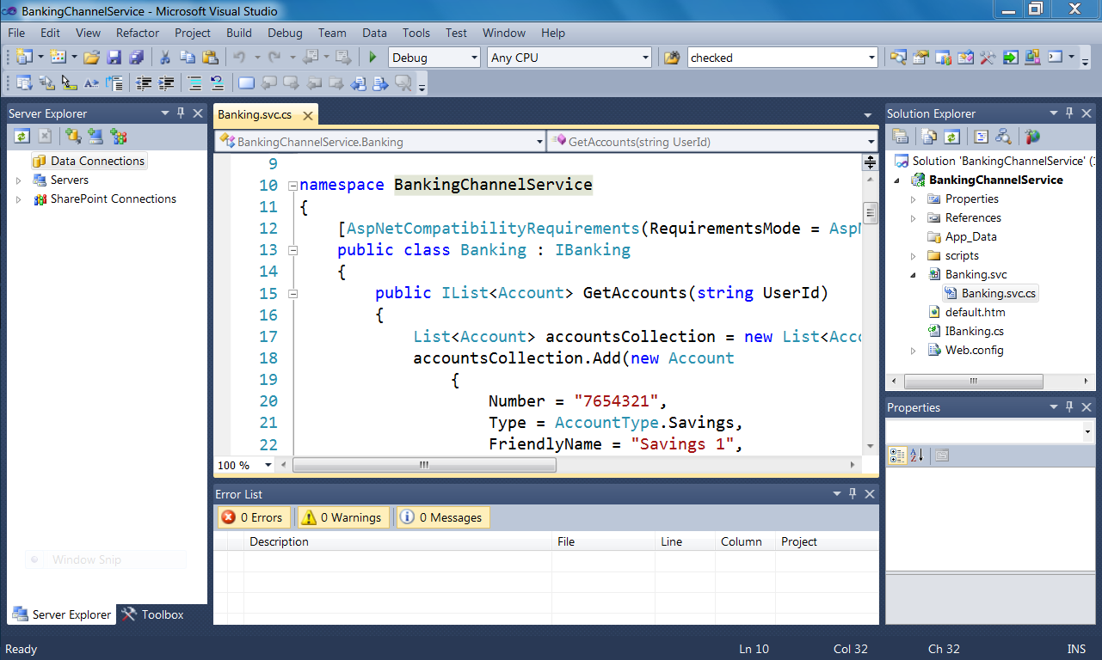
Introduction to Visual Studio 2010

Slide 8
Visual Studio project templates
Console application
WPF application
Class library
Windows Forms application
ASP.NET application
ASP.NET MVC application
WCF service application
…and many more!

Slide 9
Visual Studio projects and solutions
A Visual Studio Solution is a container for one or more Projects
A Project contains the individual files that make up an application
A solution may contain different types of projects (for example, a class library and a console application)

Slide 10
Writing a C# application
Hello, world!

Slide 11
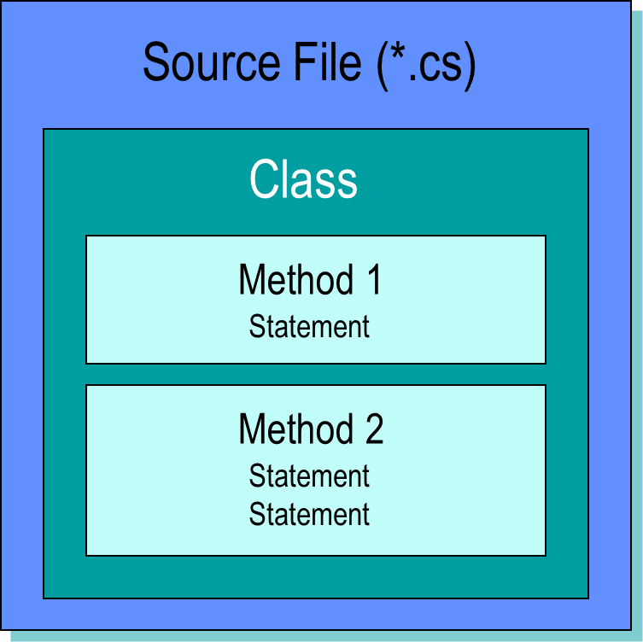
Structure of a C# program

Slide 12
Documenting an application
C# supports standard C-style comments, and XML comment blocks
Recommendations:
Begin procedures with a comment block
In longer procedures, use comments to describe units of work
Use comments when declaring variables to describe how variable will be used
Don’t use comments to describe what each line of code does; instead, document anything that’s not obvious in the code: what is the purpose of this function, why you did something a certain way, etc.

Slide 13
Debugging an application
Setting breakpoints
Stepping into and over code
Using the Debug windows

